Slide 1


The market basket analysis of Nexus
Course: Capstone: create value from open data
Student: Nino požar
13th March 2019

Slide 2
Data and analysis framework
GETTING DATA
Data is available at : UCI Machine Learning Repository
RAW VARIABLES:
InvoiceNo: Invoice number. Nominal, a 6-digit integral number uniquely assigned to each transaction. If this code starts with letter 'c', it indicates a cancellation. StockCode: Product (item) code. Nominal, a 5-digit integral number uniquely assigned to each distinct product. Description: Product (item) name. Nominal. Quantity: The quantities of each product (item) per transaction. Numeric. InvoiceDate: Invice Date and time. Numeric, the day and time when each transaction was generated. UnitPrice: Unit price. Numeric, Product price per unit in sterling. CustomerID: Customer number. Nominal, a 5-digit integral number uniquely assigned to each customer. Country: Country name. Nominal, the name of the country where each customer resides.
DATA PREPROCESSING:
Data was preprocessed by removing missing values, factorizing strings and decomposing date into day, month and year. More preprocessing was done based on analysis we were doing.
EXPLORATORY DATA ANALYSIS:
In EDA we analyzed how sales change over time, looking for patterns, we analyzed where sales come from and looked which are most profitable and most sold items.
MARKET BASKET ANALYSIS:
We completed MBA using apriori algorithm and observed which items are most frequently bought together and what are customer’s association rules.
REPORTING AND CONCLUSIONS:
Based on the analyses we have completed, we provided Nexus with informative and concise recommendations on how to implement their own recommender system that groups items frequently brought together.

Slide 3
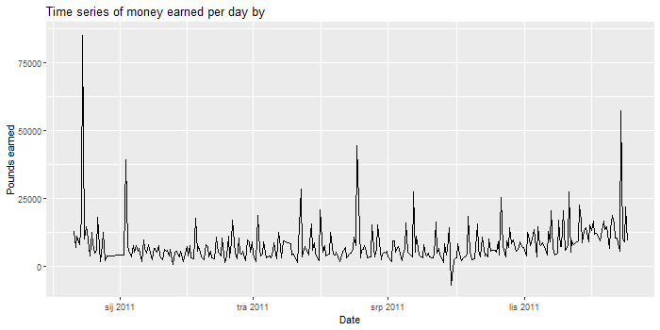
Overall sales of Nexus
Management is not satisfied with current sales.
CONCLUSIONS ABOUT DAILY SALES
Sales are pretty much static over the year
There are clear patterns of increased sales, specially around holidays in December
There is lower amount of sales on weekends, which is expected since Nexus does not accept orders on Saturdays or Sunday mornings
THE GOAL IS TO IMPROVE SALES AND GAIN PROFIT!
Table 1. Amount of sales par day of the week
Monday | Tuesday | Wednesday | Thursday | Friday | Saturday | Sunday
94933 | 101516 | 94246 | 103550 | 81835 | 0 | 64375

Slide 4
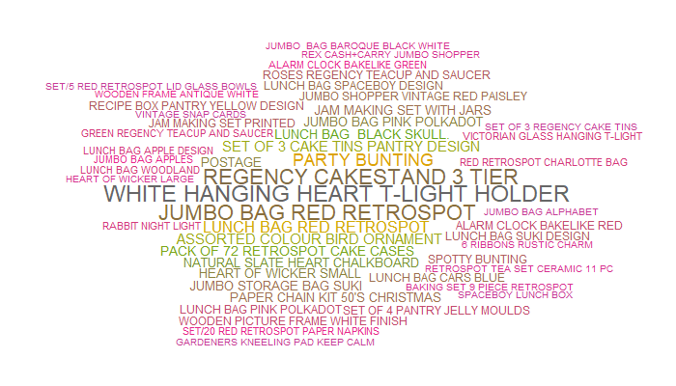
Exploratory data analysis
Word could of most frequently sold items

Slide 5
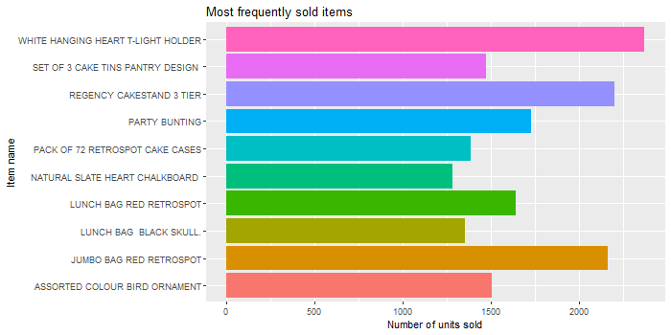
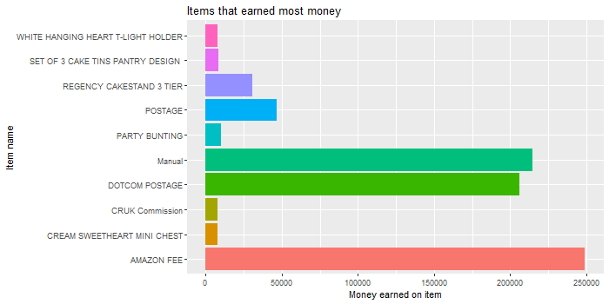
Which are most profitable items?
- Nexus mostly sells „white hanging heart t-light holder”, „regency cakestand 3 tier” and „jumbo bag red retrospot”. All those items were sold more than 2000 times in the last year.
- Nexus gains most profit from indirect costs, rather than items itself. Most money is earned on „Amazon fee”, „Manual” and „Dotcom postage”. This is valuable information that can further be used for business purposes.

Slide 6
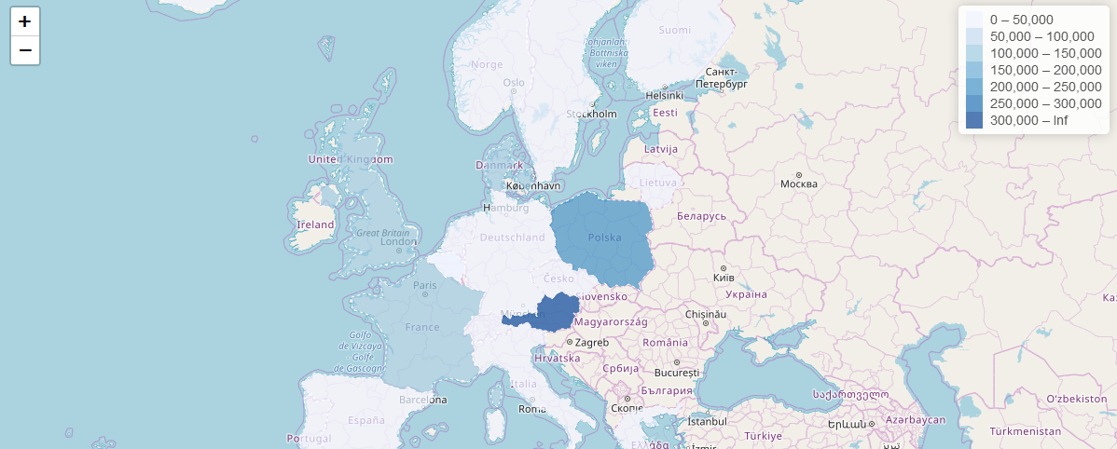
Where do our customers come from?
Europe (Austria, Poland, France and the UK)

Slide 7
EDA Conclusions
- There are no items with extremely high rate of purchase. 2369 sold items of „white hanging heart t-light holder” is most of any item and equals 0.05% of all items sold.
- Nexus could lower the costs of shipping, something that should be beneficial to both, the company and the customer.
- Even though Nexus is worldwide online retail company, it still sells most of it’s products to European market, specifically Austria, Poland, France and the UK.
- The indicators used in this analysis were correct ones and drove significant, relevant and meaningful results. The interpretation was easy and straightforward, and provided some high-end and easy-to-understand visuals.

